Slide 1

Heart Stroke Prediction System
supervisor:
Team Members:
Mr.L.Nagender Kumar.
D.Pavan Kumar (22J21A0538)
B.Sanjay (22J21A0518)
C.Siri Goud (22J21A0530)
G.Pooja (22J21A0553)

Slide 2
Field of study
Domain:
  The domain for Heart Stroke Prediction encompasses several areas, including demographic data, clinical information, laboratory results, and medical history. These factors are used to build predictive models that identify individuals at risk of developing heart disease.

Slide 3
Abstract
This abstract outlines a Heart Stroke Prediction system that leverages machine learning to accurately assess the likelihood of an individual developing heart disease based on their medical history. The system utilizes algorithms like logistic regression and KNN, demonstrating its ability to effectively classify patients and improve prediction accuracy compared to traditional methods.
Key points about the heart disease prediction system:
Focus: Predicting the risk of heart disease in individuals based on medical data.
Methods:
  Employs machine learning algorithms like logistic regression and KNN.
  Demonstrates improved accuracy compared to other classifiers like Naive Bayes
  Utilizes patient medical history to make predictions.
Goal:
  To provide a reliable and efficient system for diagnosing and potentially preventing heart disease

Slide 4

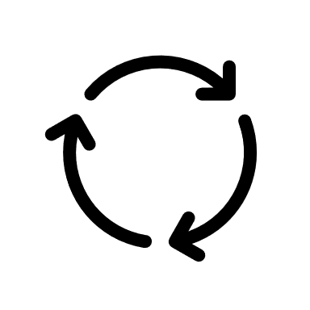





Architecture
Heart data
Data pre-processing
Train-Split
Training model
Healthy
(or)
Heart defect
New Data
Trained model
Prediction

Slide 5

Beneficiaries of the project
Patients:
  Early risk identification, allowing for preventive measures
Doctors & clinicians:
  A decision support tool to aid in diagnosing and assessing stroke risk.
Hospitals & Healthcare Providers:
  Improved resource allocation.

Slide 6
Proposed Methodology
Dataset Acquisition & Understanding.
  Source of Dataset : Kaggle
  Key features:age,gender,bmi,age,avg_BP,etc.
Data Preprocessing:
  Handling Misssing values.
  Feature Scaling Normalization
Model Implementation:
  Logistic Regression.
  K-Nearest Neighbors (KNN).
  Decision Tree
Traing and Evaluation.

Slide 7
Modules
Data Input & Preprocessing Module:
  Takes raw patient data.
  Performs data Pre-processing.
Model Training Module:
  Contains implementation of Logistis Regression, Decision tree.
  Train the preprocessed dataset.
  Saves the trained models.
Prediction Module:
  Loads a selected trained model.
  Takes new data as input.
Evaluation & Reporting:
  Uses test data to valuate and outputs stokes(0/1)
User Interface:
  Gets input from the user and provides the output

Slide 8
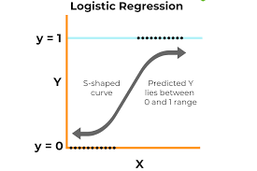
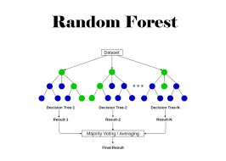
Algorithms Used
LOGISTIC REGRESSION ALGORITHM:
  Logistic regression is a supervised machine learning algorithm primarily used for binary classification tasks. It predicts the probability of a data point belonging to a specific class, typically with two possible outcomes.
RANDOM FOREST ALGORITHM:
  Random Forest is a powerful supervised machine learning algorithm that uses an ensemble of decision trees to make predictions.

Slide 9
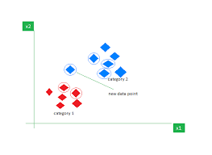
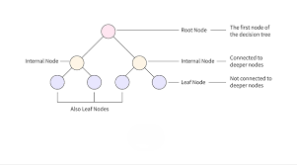
Algorithms used
K-NEAREST NEIGHBOR(KNN)ALGORITHM:
  The k-nearest neighbors (KNN) algorithm is a non-parametric, supervised learning classifier, which uses proximity to make classifications or predictions about the grouping of an individual data point
DECISION TREE CLASSIFICATION ALGORITHM:
  A decision tree in machine learning is a flowchart-like structure used for both classification and regression tasks. It breaks down complex decisions into simpler, hierarchical steps, making it easy to understand and interpret

Slide 11
Thank You

